Slide 1


Slide 2

Migration Overview
Anca Naiman

Slide 3

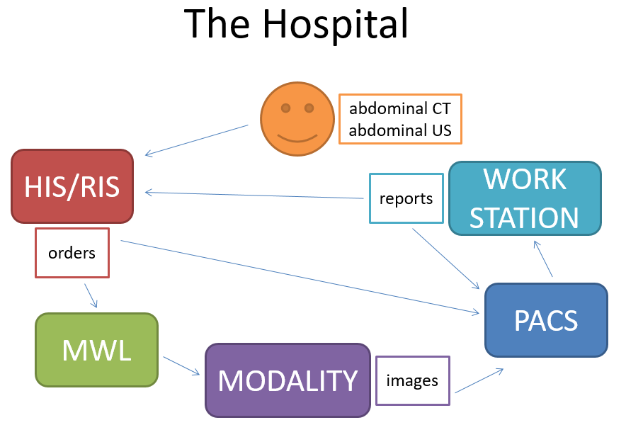
HIS → Manage all the aspects of a hospital's operation, such as medical, administrative, financial, and legal issues and the corresponding processing of services
RIS-→ Patient scheduling, resource management, examination performance tracking, reporting, results distribution, and procedure billing
Modality → the kind of device which performs the radiological examination, such as a CT machine, an MRI machine, an ultrasound machine, and so on).
PACS→ a medical imaging technology which provides economical storage and convenient access to images from multiple modalities (source machine types)
Notes:
The physician places one or more orders for these x-ray procedures with the RIS. When an order is entered, a order message is triggered and sent from the RIS to the Modality Worklist, which keeps a list of all of the patients who are to receive a radiological exam of one kind or another. A modality refers to the kind of device which performs the radiological examination, such as a CT machine, an MRI machine, an ultrasound machine, and so on). The order contains details about when the exam is scheduled, what type of imaging procedure is going to be performed, the location of the exam (which imaging room, which modality) etc.

Slide 4
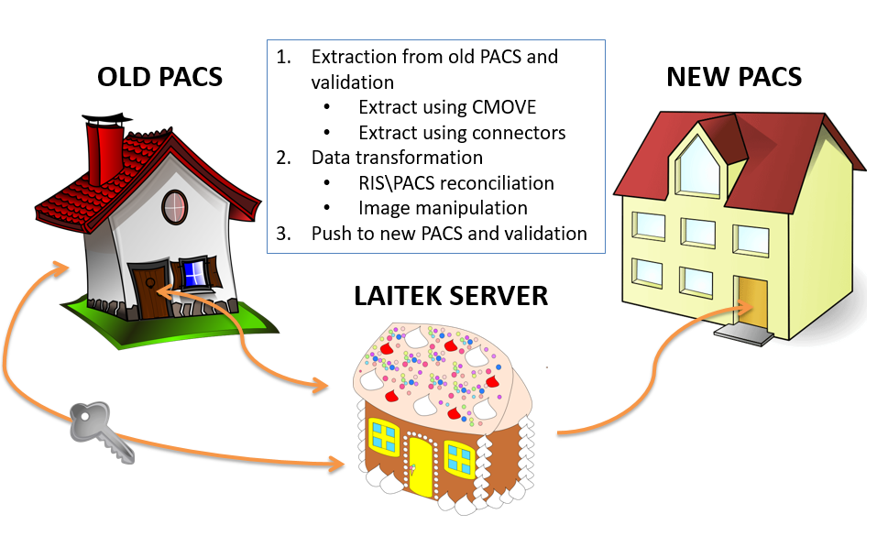
Migration

Slide 5
Protocols
DICOM is used for image transfer;
HL7 is used for other types of information transfer, such as patient information, or orders and reports.

Slide 6
DICOM: Data Format
Series Series Instance UID
e.g., A series without contrast, a series performed 5 minutes after contrast was administered, a series performed 15 minutes after contrast was administered)
Image
SOP Instance UID
Image
Pixel data can be uncompressed (raw) or compressed using various standards (for example, JPEG, JPEG lossless, JPEG 2000). This is specified by the Transfer Syntax.
Image
For example, a chest X-ray image) contains, besides the actual image (called pixel data), other information (called attributes), such as the name of the patient, the ID of the patient, the date on which the image was performed etc→ DICOM Tags
Study Study Instance UID
A collection of images performed as part of an examination (for example, a head CT)
Resources: http://192.168.0.162/mediawiki/index.php/DICOM_standard_and_processes
http://192.168.0.162/mediawiki/index.php/Medical_images_samples_with_various_compression_types#BW_US
Notes:
1980 In the beginning… it was very difficult for anyone other than manufacturers of computed tomography (CT) or magnetic resonance imaging (MRI) devices to decode the images that the machines generated, or to print them.
1983
The American College of Radiology (ACR) and the National Electrical Manufacturers Association (NEMA) joined forces and formed a standards committee to meet the combined needs of radiologists, physicists and equipment vendors.
https://www.dicomstandard.org/history/

Slide 7
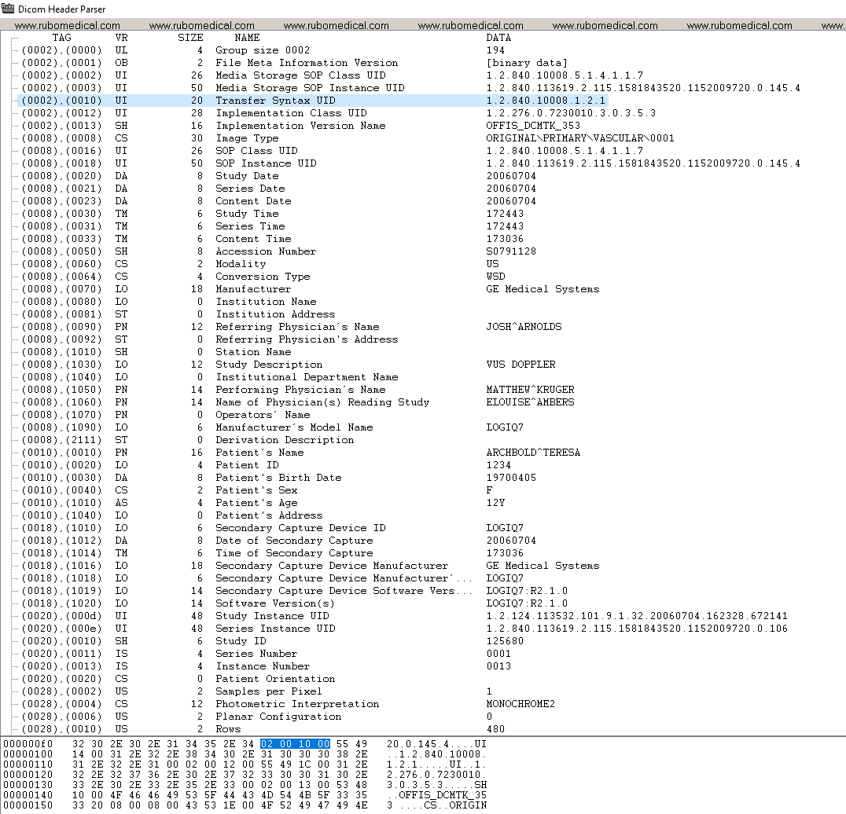
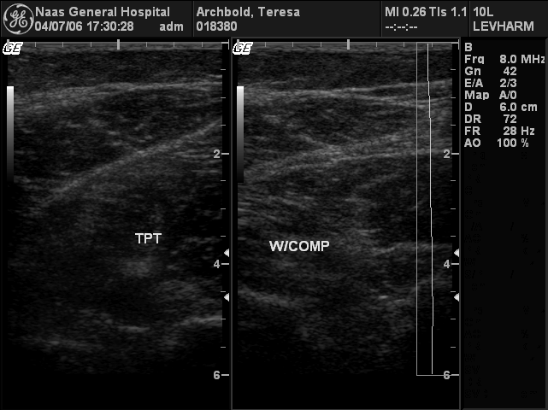
Reading DICOM Information
DICOM has meta information which is composed of a set of tags. Each type of tag represents an element or a piece of information regarding the file, this includes patient information, modality information, study information, and so on.
Efilm and DICOM Header Parser are just two examples of applications that let us view this information and even edit it. See example below:

Slide 8
DICOM: Communication
Application Entity (AE)
Application Entity (AE)
There are different types of communication between application entities. These are specified by the Service Class:
storage service class – for storing data,
query/retrieve service class – for querying for data/retrieving data
Resource http://192.168.0.162/mediawiki/index.php/DICOM_standard_and_processes
Notes:
The systems (processes) that communicate using DICOM are called application entities. An application entity is identified by an AE Title (for example, CT_Room1 or MIGR_QUERYSCU or GEPACS). The application entity uses this AE Title to identify itself to other devices it communicates with.
There are different types of communication between application entities. These are specified by the Service Class: e.g. storage service class – for storing data, query/retrieve service class – for querying for data/retrieving data.
When AEs communicate, they can play two different roles: Service Class User (SCU) and Service Class Provider (SCP).
For example, when AE CT_Room1 sends images to AE GEPACS, these play the following roles:
GEPACS AE is a Storage Service Class Provider (SCP) – it offers the option to store the images;
CT_Room1 AE is a Storage Service Class User (SCU) – it asks the other AE to store the images.
The communication between two AEs is done through associations. An association is a connection established between 2 AEs. In order to be able to communicate, the AEs will negotiate the association: they will determine if they know how to exchange the data. For example, an ultrasound unit would ask the printer if it supports color. If not, then it can decide that black/white is good enough and send the images, or it can decide not to send to this printer and choose a different printer which does support color (depending on how it is setup).

Slide 9







The DICOM Gift C-FIND & C-MOVE to third party
CMOVE
Romania
USA
CFIND
France

Slide 10
The DICOM Gift C-FIND & C-MOVE to self & C-STORE
C-STORE
C-MOVE
Romania
Romania
C-FIND
France

Slide 11
Migration in a nutshell
1.Setup
2.Data cleansing: reconciliation and transformations
3.Extracting from legacy into buffer storage
4.Migrating into the target from the buffer
5.Project close

Slide 12

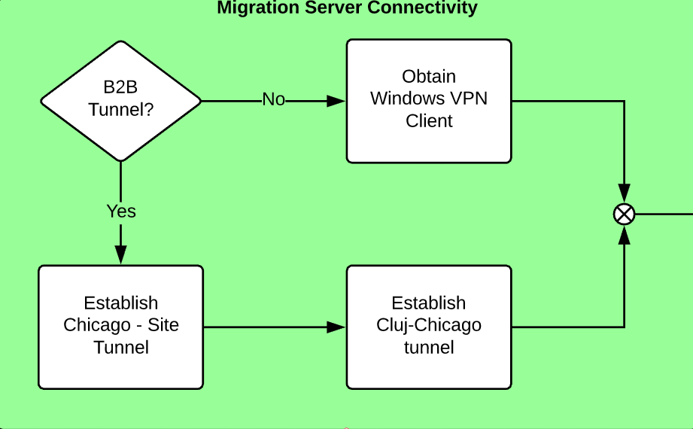
Migration Setup – Server Connectivity

Slide 13
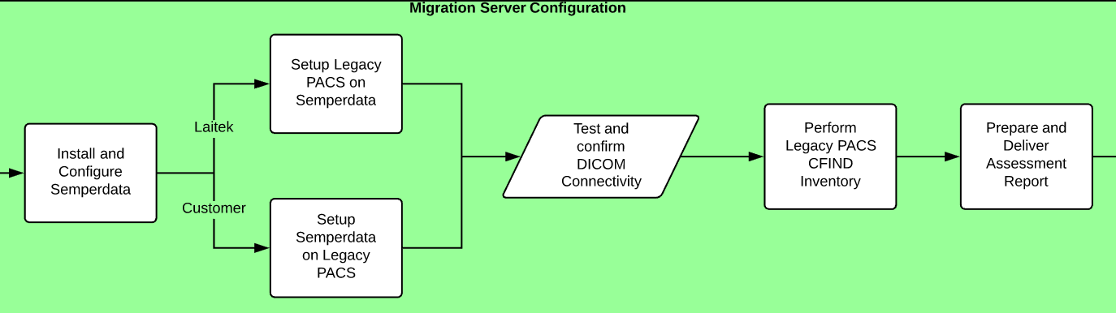
Migration Setup – Server Configuration

Slide 14
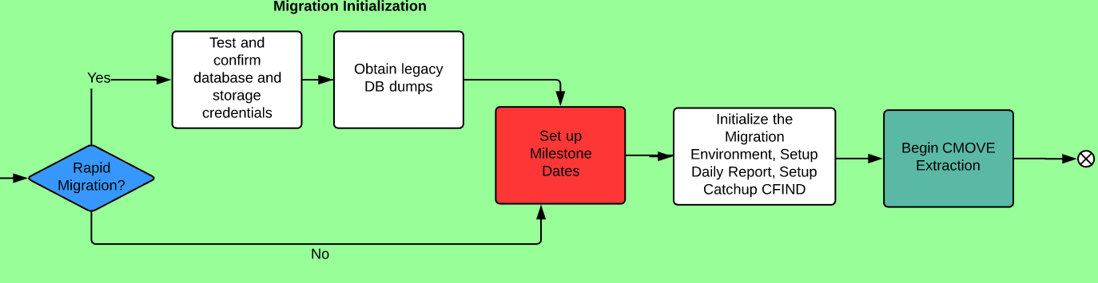
Migration Setup - Initialization

Slide 15
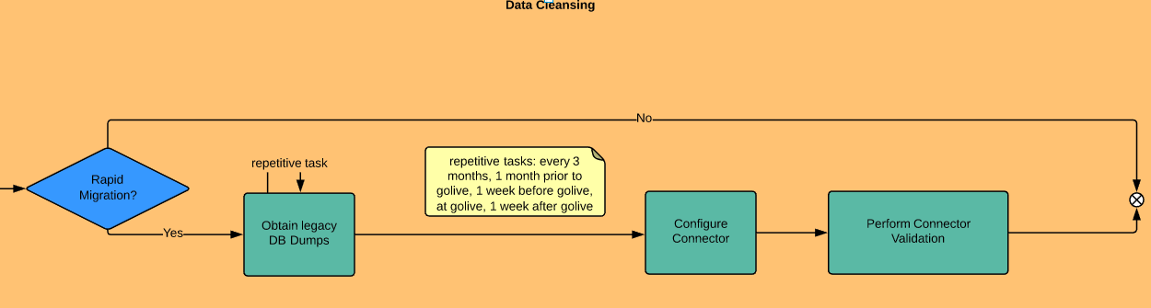
Data Cleansing and Staging

Slide 16
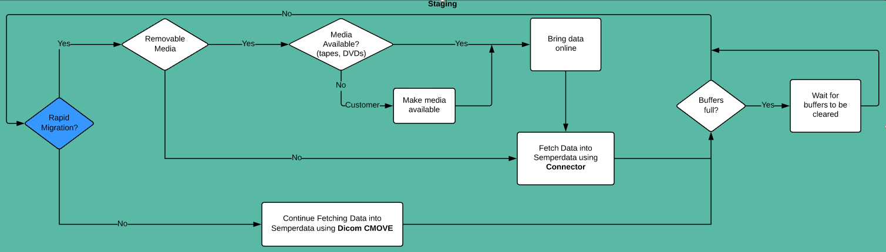
Staging

Slide 17
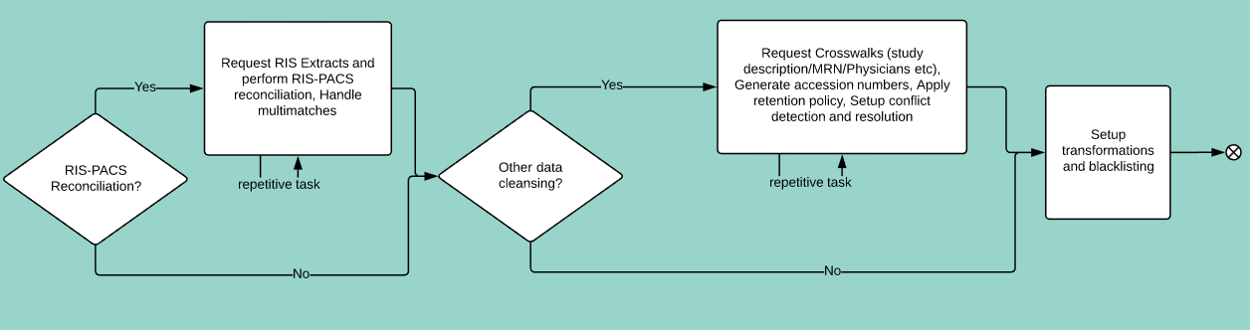
Data cleansing

Slide 18
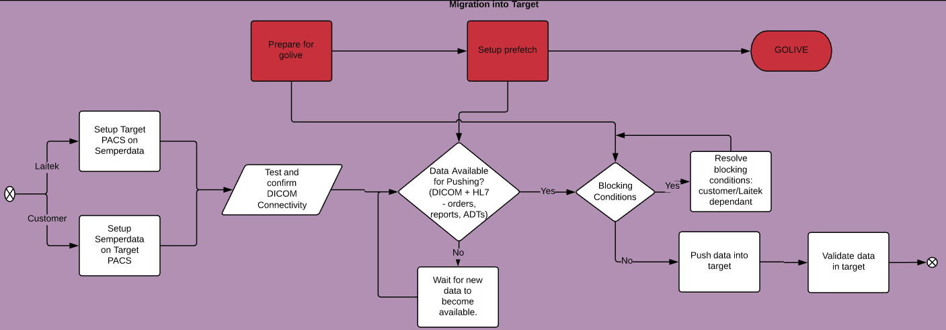
Migration into Target

Slide 19
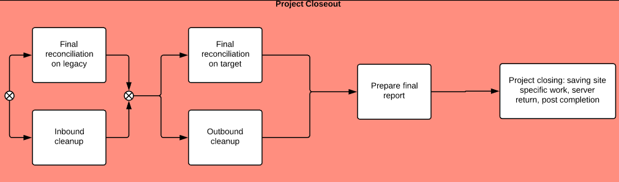
Project Closeout

Slide 20
Thank you!

